Slide 1
Primary Key and Secondary Key
JSON, XML, Joins

Slide 2
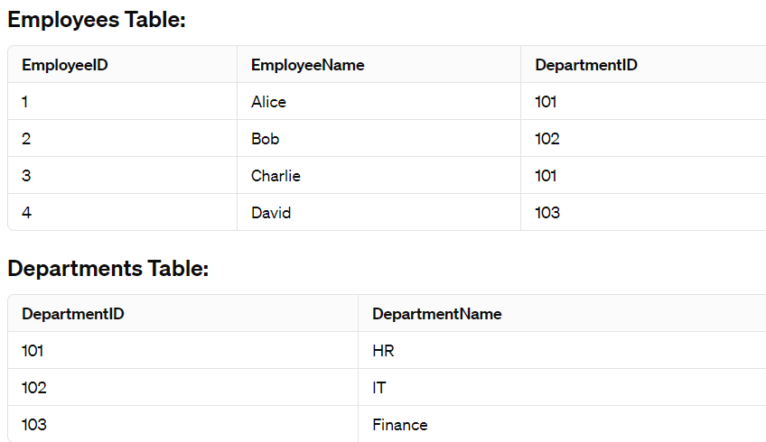
Employee and Department Tables

Slide 3
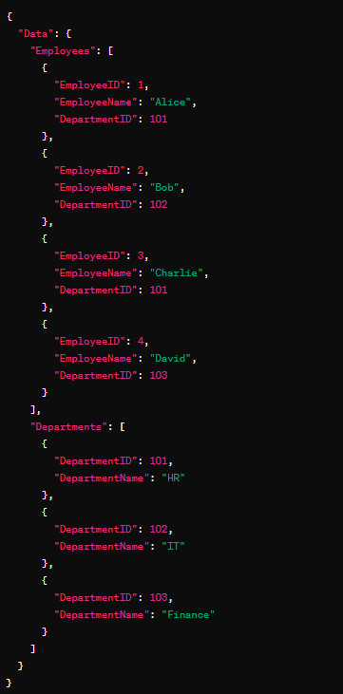
JSON

Slide 4
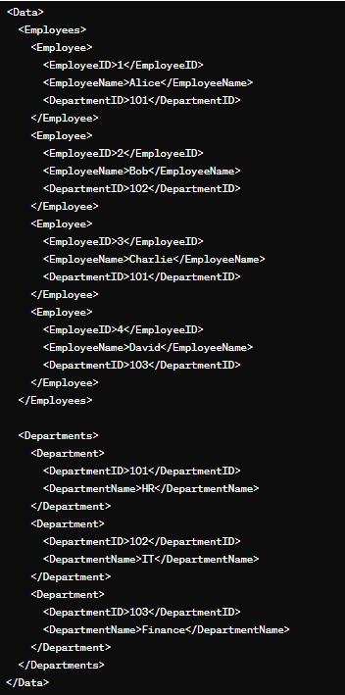
XML Format

Slide 5
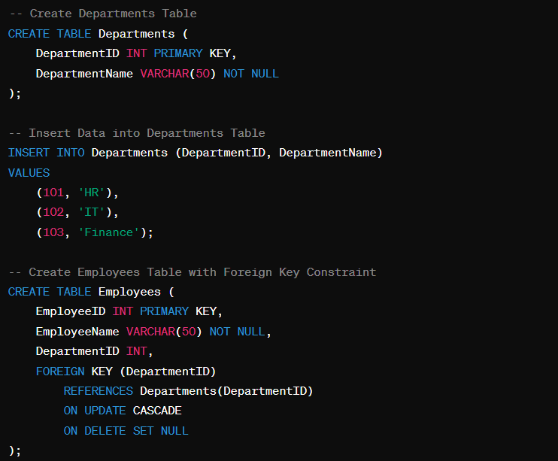
SQL For Employee and Department Tables

Slide 6
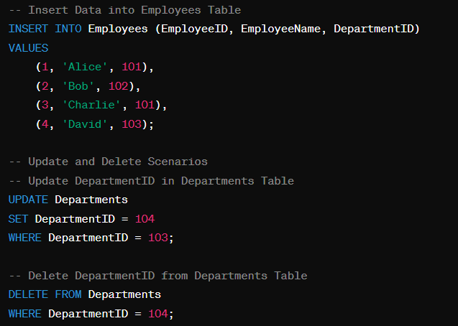
SQL For Employee and Department Tables …

Slide 7
SQL For Employee and Department Tables …
The ON UPDATE CASCADE clause ensures that if the DepartmentID in the Departments table is updated, the corresponding DepartmentID in the Employees table will also be updated.
The ON DELETE SET NULL clause ensures that if a department is deleted from the Departments table, the DepartmentID in the corresponding rows of the Employees table

Slide 8
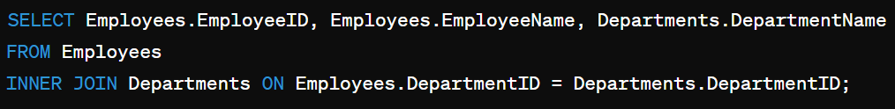
INNER JOIN
Retrieves rows when there is a match in both tables based on the specified condition.

Slide 9
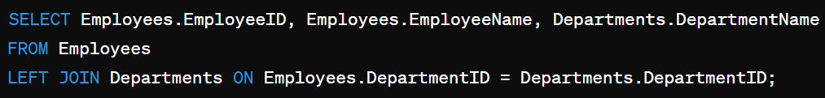
LEFT JOIN (or LEFT OUTER JOIN)
Retrieves all rows from the left table and the matched rows from the right table. If there is no match, the result will contain NULL values for columns from the right table.

Slide 10
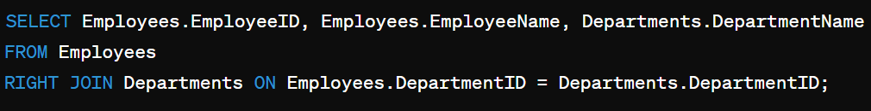
RIGHT JOIN (or RIGHT OUTER JOIN)
Retrieves all rows from the right table and the matched rows from the left table. If there is no match, the result will contain NULL values for columns from the left table.

Slide 11
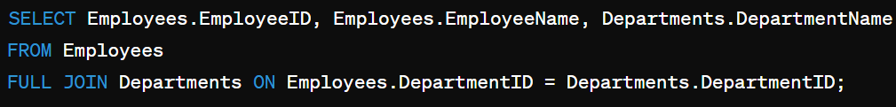
FULL JOIN (or FULL OUTER JOIN)
Retrieves all rows when there is a match in either the left or right table. If there is no match, the result will contain NULL values for columns from the table without a match.

Slide 12
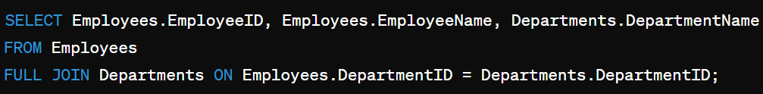
FULL JOIN (or FULL OUTER JOIN)
Retrieves all rows when there is a match in either the left or right table. If there is no match, the result will contain NULL values for columns from the table without a match.

